Slide 1




PDS
Computer Vision
Cloud Service Models
https://github.com/siagianp
https://www.youtube.com/@AmelOline/videos
https://github.com/amelcharolinesgn2/Cloud-Infrastructures
https://github.com/amelcharolinesgn2/ClouD-Infrastructure-SISKA-2025
https://github.com/amelcharolinesgn2/CCNA1
https://github.com/amelcharolinesgn2/CCNA2
https://github.com/amelcharolinesgn2/AWS Certificate
Notes:
Lab Session 01: AWS Compute Foundations – EC2, Networking, and Application Deployment Lab Session 02: Identity and Access Control with IAM Lab Session 03: Cloud Storage Solutions – S3, EBS, and EFS Lab Session 04: Database Services – RDS, DynamoDB, and ElastiCache Lab Session 05: Load Balancing and Auto Scaling Lab Session 06: Container Orchestration with ECS, Fargate, and EKS Lab Session 07: Serverless Computing with Lambda Lab Session 08: Monitoring, Logging, and Security Auditing Lab Session 09: Infrastructure as Code – CloudFormation, CDK, and Terraform Lab Session 10: CI/CD Pipelines – App Runner, CodePipeline, GitHub Actions, and CodeDeploy Lab Session 11: AI/ML Services – Rekognition, Comprehend, Translate, and SageMaker Lab Session 12: Hybrid Cloud Networking – VPC Peering, Transit Gateway, VPN, and Direct Connect Lab Session 13: Security and Compliance – AWS Config, GuardDuty, Security Hub, and KMS Lab Session 14: Disaster Recovery and Business Continuity – AWS Backup, Multi-Region, and Failover Lab Session 15: Migration and Modernization – DataSync, DMS, MGN, Containers, and Serverless
Lab Session 16: Cost Management and Optimization – Cost Explorer, Trusted Advisor, Budgets, and Well-Architected
https://www.youtube.com/watch?v=SOTamWNgDKc&t=19604s

Slide 2
Cloud Service Models
Understanding IaaS, PaaS, and SaaS

Slide 3
Introduction to Cloud Service Models
Definition:
Service models define how cloud services are delivered to users, based on the level of control and management responsibility.
Key Service Models:
Infrastructure as a Service (IaaS)
Platform as a Service (PaaS)
Software as a Service (SaaS)

Slide 4
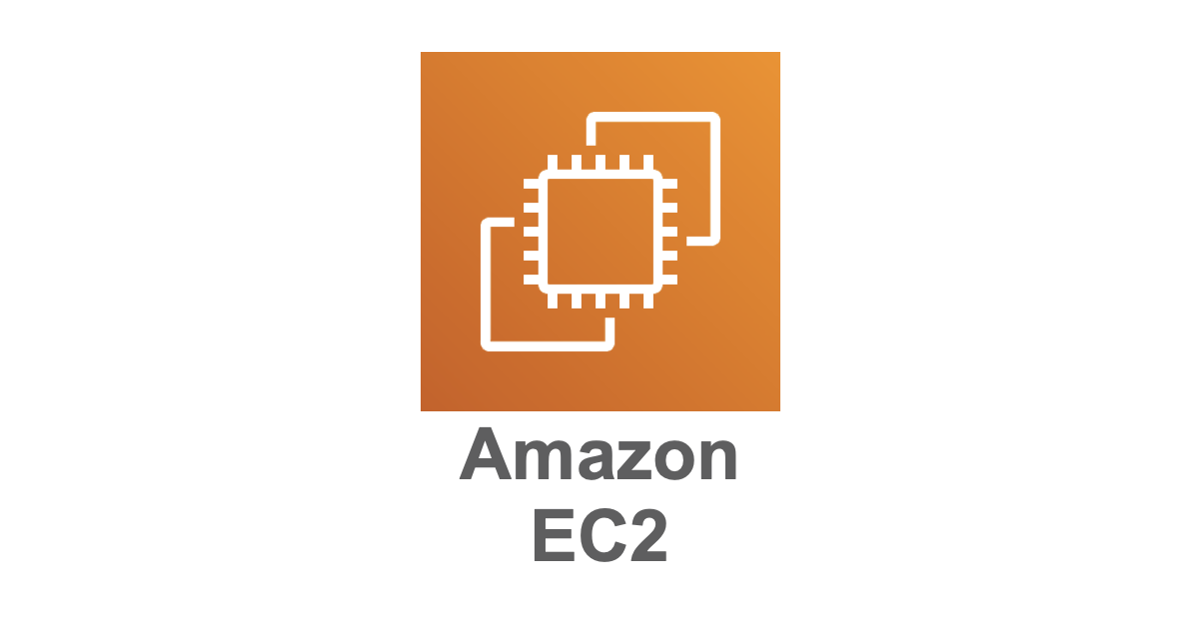
1. Infrastructure as a Service (IaaS)
Provides virtualized computing resources over the internet.
Users manage operating systems, applications, and data while the cloud provider manages hardware and virtualization.
Examples:
Amazon Web Services (AWS) EC2
Google Compute Engine
Microsoft Azure Virtual Machines
Key Features:
Virtual machines, storage, and networks.
High flexibility and scalability.

Slide 5
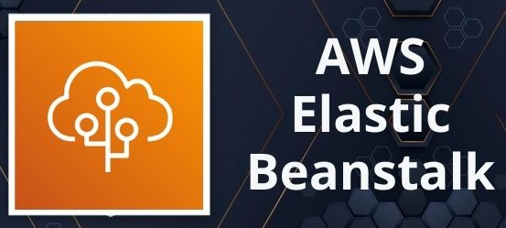
2. Platform as a Service (PaaS)
Provides a platform that allows developers to build, test, deploy, and manage applications without worrying about the underlying infrastructure.
The cloud provider manages OS, runtime, and middleware.
Examples:
Google App Engine
Microsoft Azure App Service
AWS Elastic Beanstalk
Heroku
Key Features:
Simplifies development and deployment.
Ideal for application development without infrastructure management.

Slide 6

3. Software as a Service (SaaS)
Delivers software applications over the internet on a subscription basis.
Users access applications via a web browser while the cloud provider manages everything.
Examples:
Gmail
Microsoft Office 365
Salesforce
Key Features:
No installation required.
Accessible from anywhere with an internet connection.

Slide 7
Key Differences Between Service Models
Aspect | IaaS | PaaS | SaaS
User Responsibility | Apps, data, OS | Apps, data | Only usage
Provider Responsibility | Hardware, virtualization | Hardware, OS, runtime | Everything
Use Case | Full Controll and flexibility | Development platforms | End-user applications

Slide 8
Advantages and Disadvantages
IaaS:
Advantages: High control and scalability.
Disadvantages: Complex management required.
PaaS:
Advantages: Simplifies app development.
Disadvantages: Limited control over the environment.
SaaS:
Advantages: Easy to use and maintain.
Disadvantages: Limited customization.

Slide 9


Case Study – Comparing Real-World Examples
IaaS Example:
Use AWS EC2 to host a website where you manage the server, storage, and OS.
PaaS Example:
Use Heroku to develop and deploy a web application.
SaaS Example:
Use Gmail for email management.

Slide 10
Identify the Service Model
Example 1: Hosting a virtual machine on Azure.
Example 2: Building a web app on AWS Elastic Beanstalk.
Example 3: Using Dropbox to store files.

Slide 11
Identify the Service Model
Example 1: Hosting a virtual machine on Azure. (Answer: IaaS)
Example 2: Building a web app on AWS Elastic Beanstalk. (Answer: PaaS)
Example 3: Using Dropbox to store files. (Answer: SaaS)

Slide 12
Summary
Cloud service models offer varying levels of control and abstraction.
IaaS: High control over infrastructure.
PaaS: Simplifies app development.
SaaS: End-user applications delivered over the internet.

Slide 13
THANK YOU
Amel Online & Irene magdalena
https://github.com/siagianp
https://www.youtube.com/@AmelOline/videos
https://github.com/amelcharolinesgn2/Cloud-Infrastructures
https://github.com/amelcharolinesgn2/ClouD-Infrastructure-SISKA-2025
https://github.com/amelcharolinesgn2/CCNA1
https://github.com/amelcharolinesgn2/CCNA2
https://github.com/amelcharolinesgn2/AWS Certificate

